Slide 1
Weekly project 2 : creating a database
Felicia, Mathieu

Slide 2
Summary
Description of the project
Challenges
Process
Main results
Demo (ONE MINUTE)

Slide 3
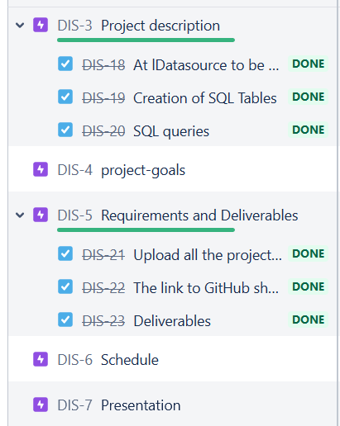
Description of the project
Goal: create a database related to the business socio-economic factor
Selecting relevant data to compare the countries
Find out which country performs the best regarding the factors
Using python and sql

Slide 4
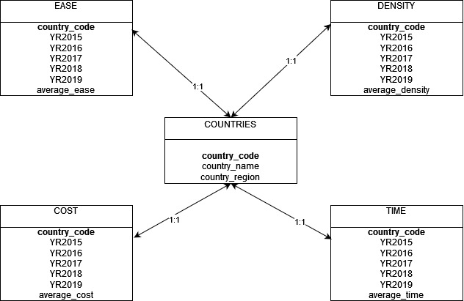
Challenges
Planification of the project in Jira
Acquire the data using scraping or API
Creation of the ER model
Getting some insights of the data using sql queries
Normalisation of the data

Slide 5
Process
Finding out relevant data concerning the business indicator
Creating an ER model to understand how we need to create the database
Data extraction
Compiling every data into a database in sql
Making sql queries and data normalisation to rank countries

Slide 6
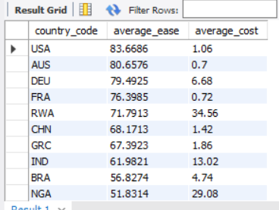
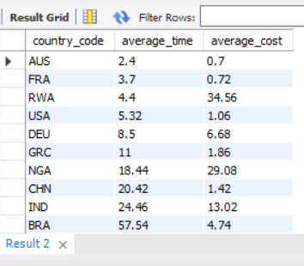
Main results
The ease of doing business (0 = lowest performance to 100 = best performance)
Time required to start a business (days)
New business density (new registrations per 1,000 people ages 15-64)
Cost of business procedures (% of Gross National Income per capita)

Slide 7
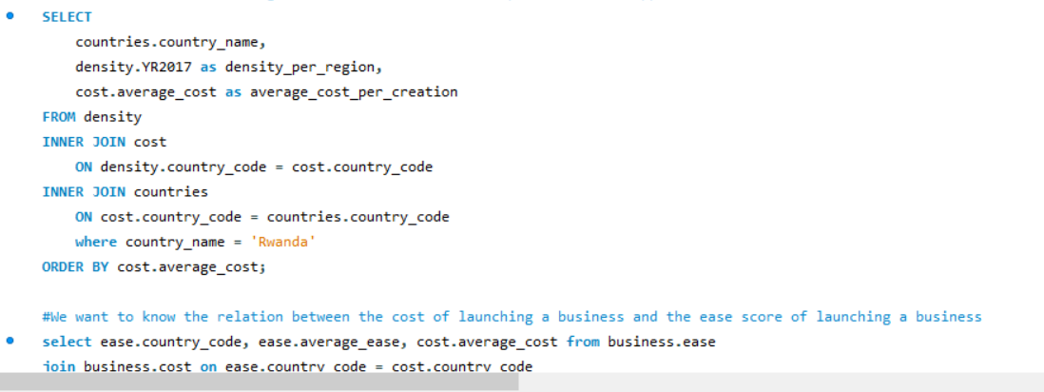
DEMO

